Slide 1
資料科學與基因體研究
應數系 簡立欣
科學統計 2024-03-05

Slide 2
Outline
Background for the Genomic Data Science
基因體資料科學背景簡介
Genome-Wide Association Studies
基因體關聯性分析
Principle Component Analysis
主成份分析

Slide 3
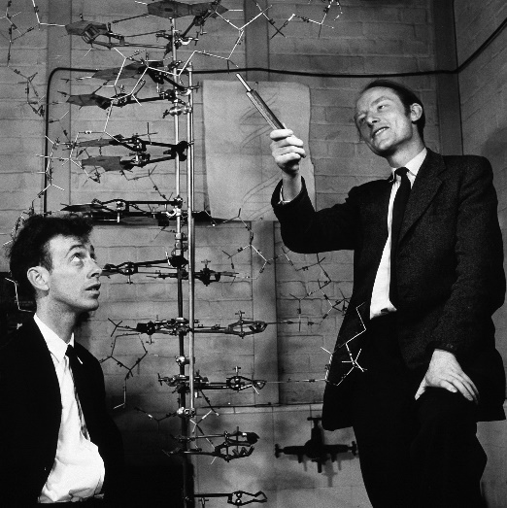
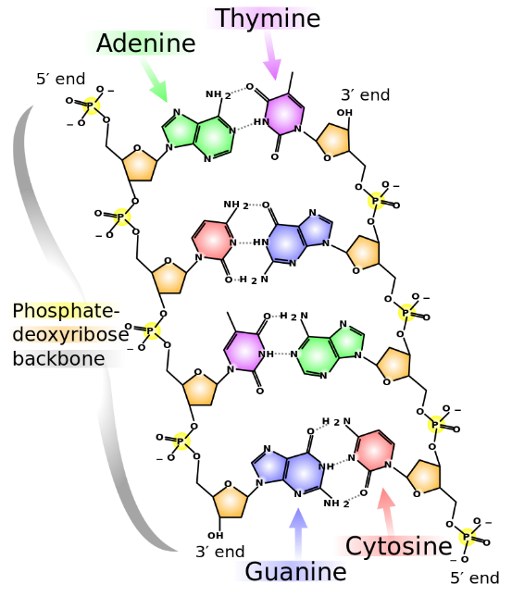
1953: DNA Double Helix
Watson (left) & Crick (right),
published their findings that the molecular structure of DNA was a double helix.
Their work helped to explain how DNA replicates and how hereditary(遺傳的) information is coded on it.
1962 Nobel Prize
https://en.wikipedia.org/wiki/DNA

Slide 4
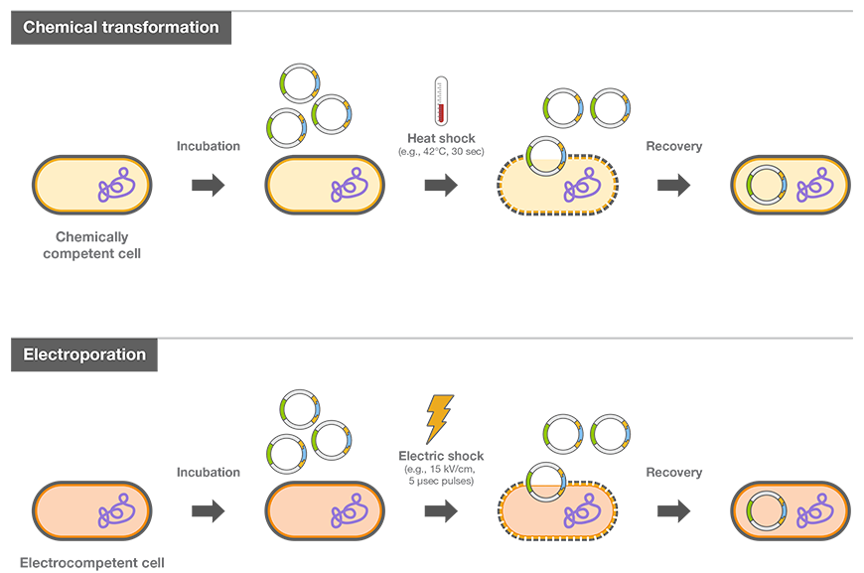
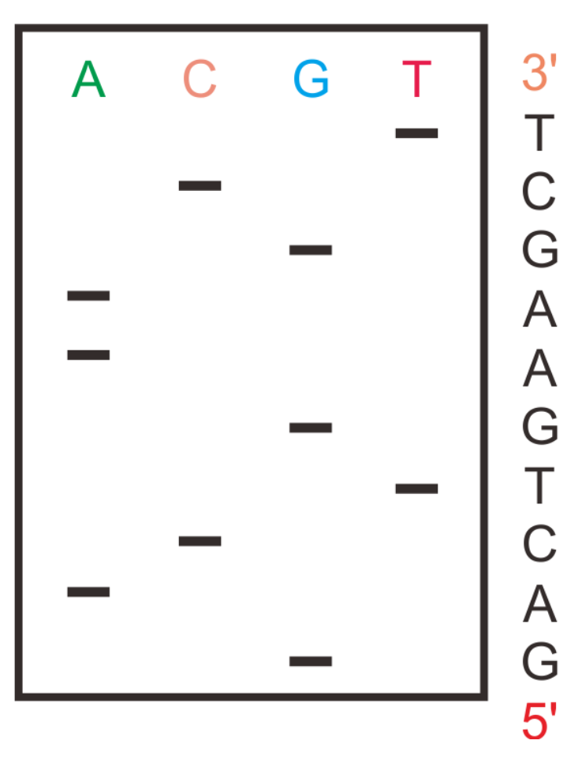
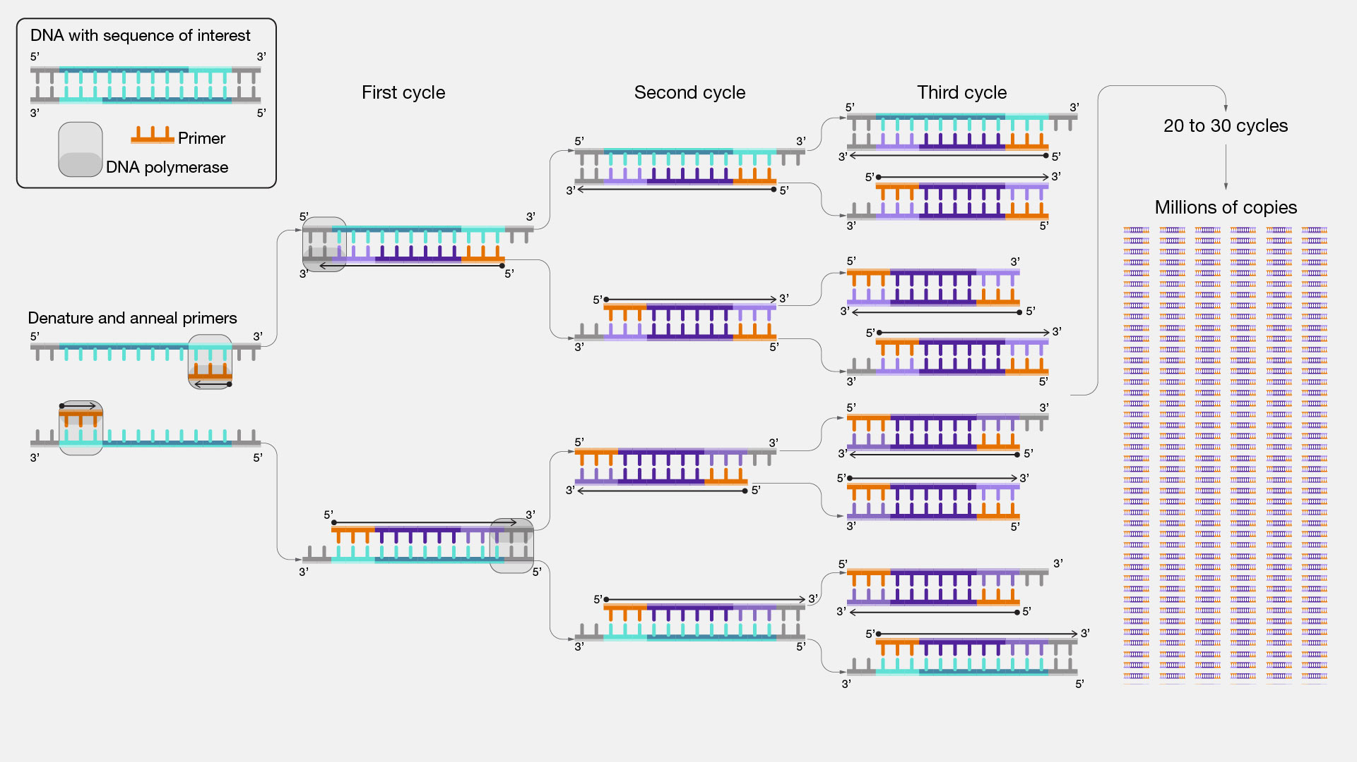
1983: PCR invented
Polymerase chain reaction (PCR): (1983)
a method to make millions to billions of copies of a specific DNA sample rapidly.
Simple, cheap, reliable (可靠)
Before PCR: DNA Cloning
Difficult, time consuming
Bacterial (細菌) cells
DNA Sequencing (1977) (基因定序)

Slide 5
1990 – 2003 Human Genome Project
Inherited disease: stroke (中風), cancer,…
The project was a 13-year-long, publicly funded project (expect to be a 15-year initiative)
$3-billion project was formally launched in 1990 by the US
A parallel project was conducted outside the government: Celera Corporation (1998)

Slide 6
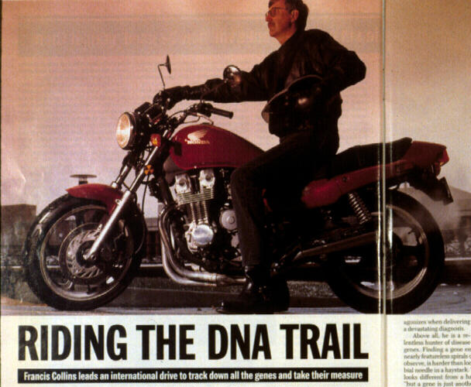
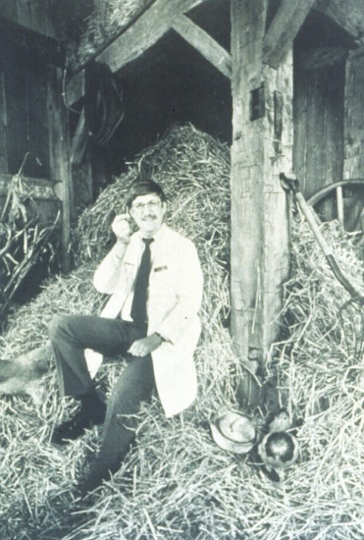

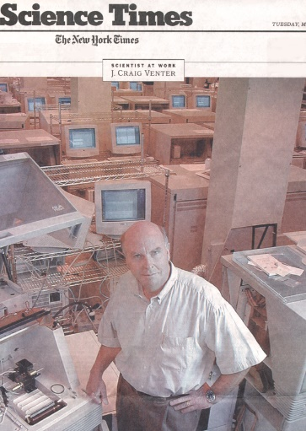




Two Major Protagonists(主角) of HGP Drama
Francis Collins
Craig Venter
Notes:
Front cover

Slide 7
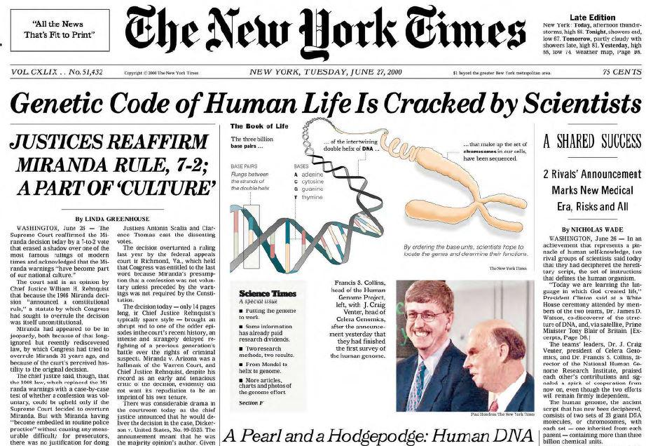

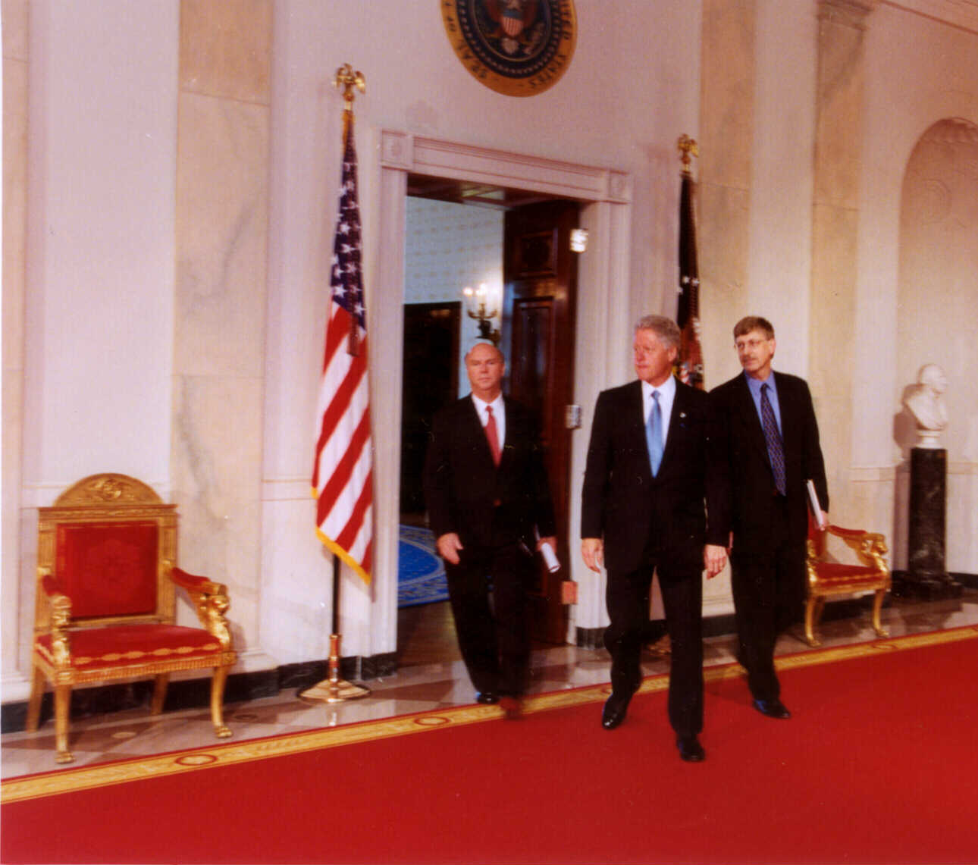

Slide 8
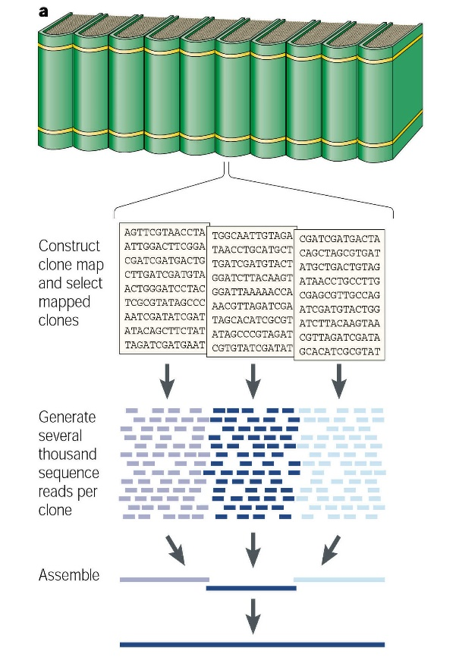
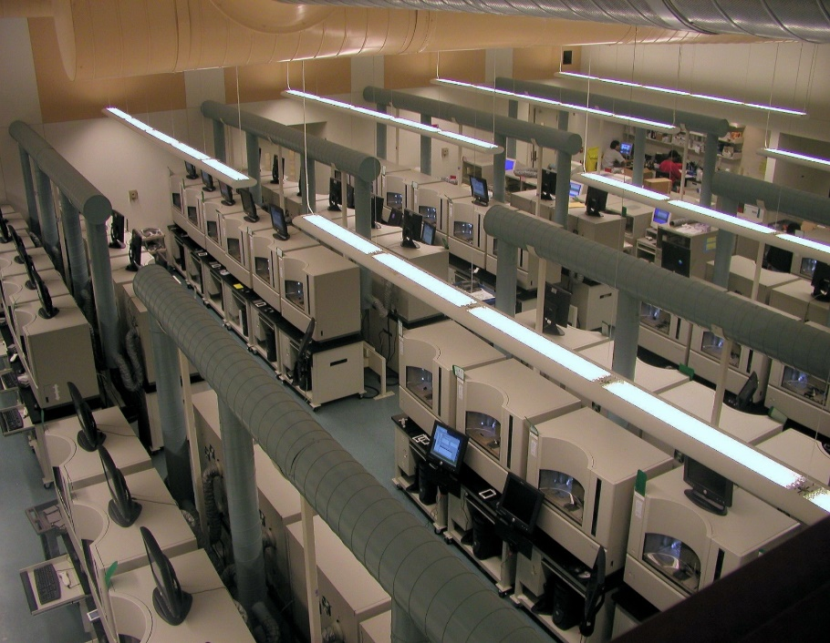

Generating the First Human Genome Sequence
Initial HGP Plan
Automation & Scale
Computational Power
6 Countries, 20 Centers, 1000’s of researchers
~1,000 bases/second, 24 hours/day, & 7 days/week for ~6 years
Brute force using Sanger DNA sequencing and massive computational help

Slide 9
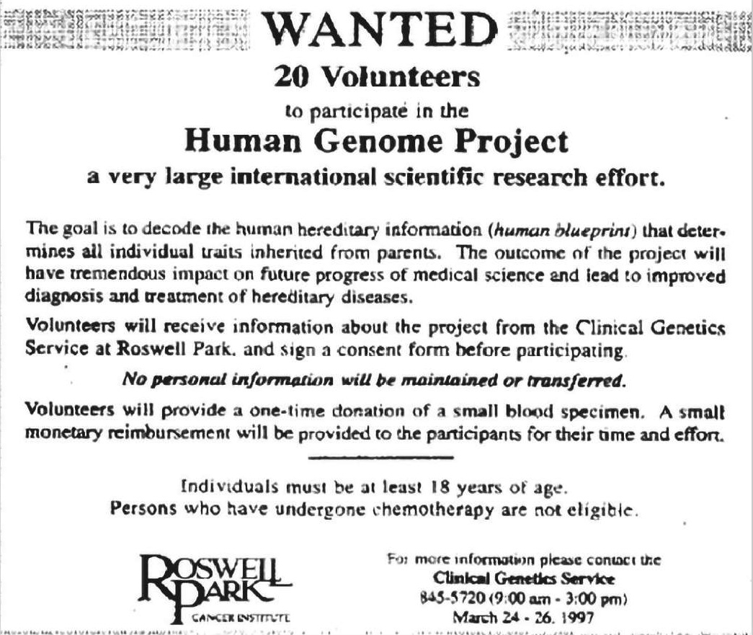
Whose Genome Was Sequenced by HGP?
Buffalo, NY blood donors
93% of HGP’s human genome sequence from 11 donors
70% of HGP’s human genome sequence from 1 donor
HGP human genome sequence was a ‘mosaic’ representation of multiple people (a ‘reference’)
Humorous Aside: Advocacy(宣傳) by some HGP researchers to select a ‘normal’ person and sequence their genome first – as if anyone knows what ‘normal’ means!

Slide 10
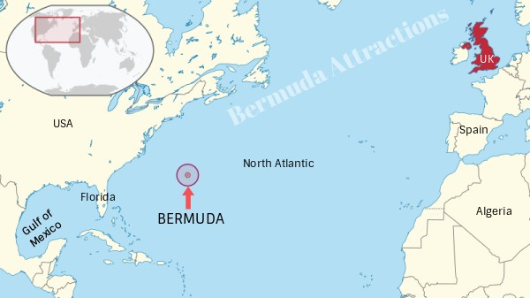
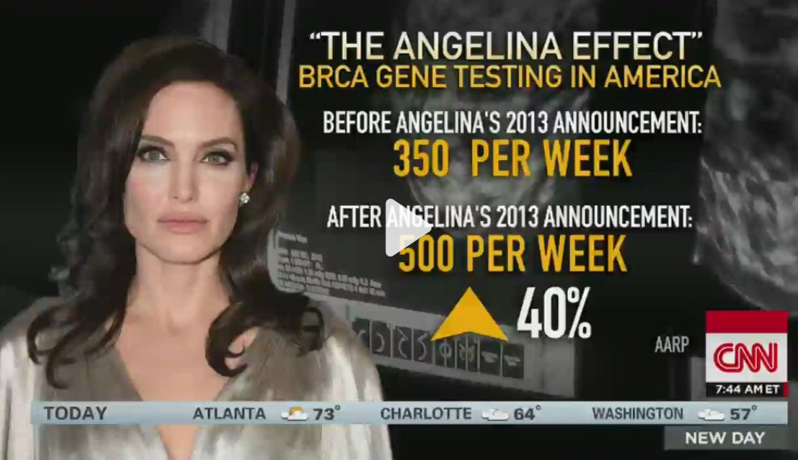
Bermuda Principles for Data Sharing
Significant attention to release and sharing of HGP genome sequence data
Landmark agreement for rapid data release and public access to HGP genome sequence data
Among the most important legacy of HGP
Can genes be patented?
On June 13, 2013, the Supreme Court of the United States ruled that human genes cannot be patented in the U.S. because DNA is a "product of nature." Prior to this ruling, more than 4,300 human genes were patented. The Supreme Court's decision invalidated those gene patents, making the genes accessible for research and for commercial genetic testing. Ex: BRCA1/2 for breast cancer

Slide 11
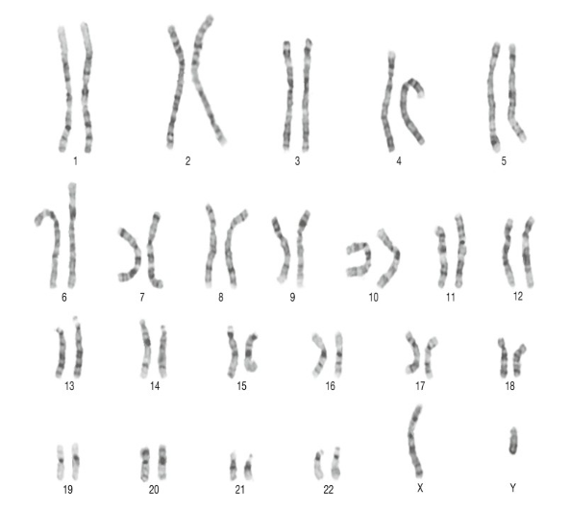
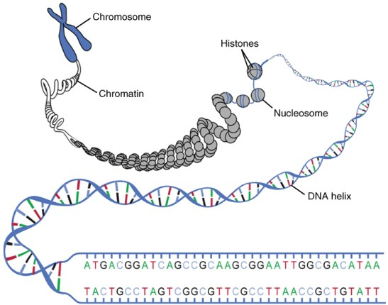
DNA sequence
https://www.sciencedirect.com/topics/immunology-and-microbiology/human-chromosome
https://pediaa.com/difference-between-chromosome-and-chromatid/

Slide 12
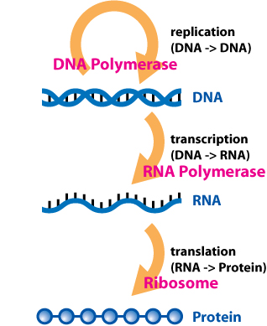
The Central dogma
The Central dogma: Crick, 1956

Slide 13
DNA Double Helix & The Central dogma
+ Environmental effect: smoke, Plasticizer,….
Methylation data
(Epigenomic)
SNP Array data (Genomic)
Gene expression microarray data (Transcriptomic)

Slide 14
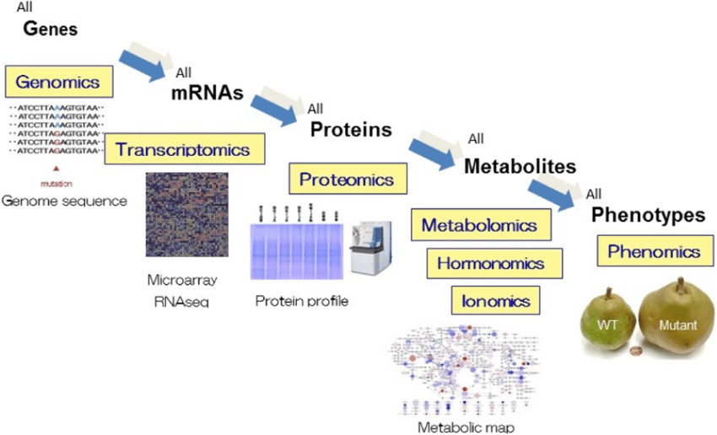
Omics Data (數據組學)
Genomic
Transcriptomic
Epigenomic

Slide 15
Big Data: 5V
Coding
Statistics
Volume (數據量)
Variety (多樣性)
Velocity (速度)
Veracity (真實性)
Value (價值性)
Data
Science
Domain
expertise

Slide 16
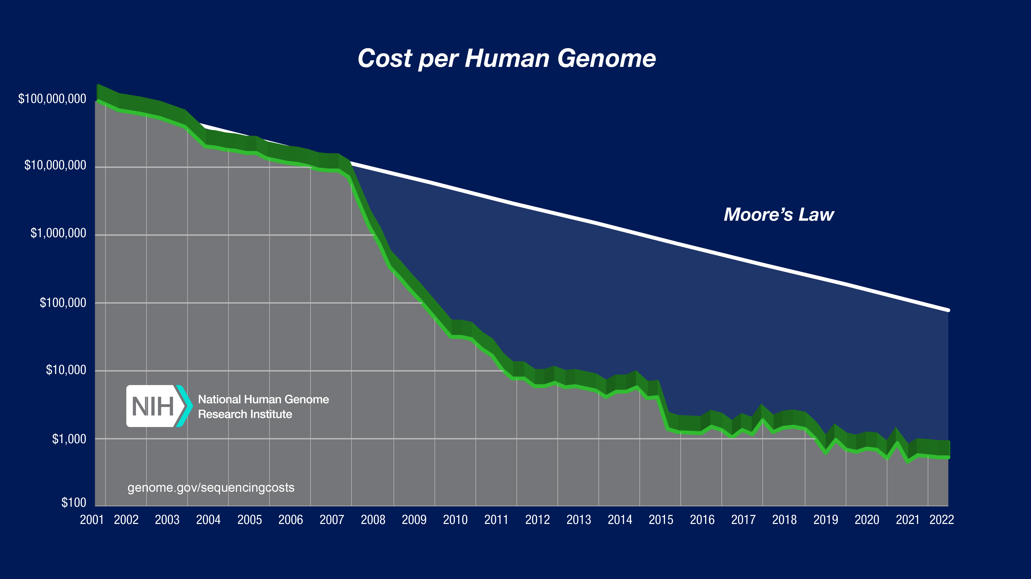
Cost per Human Genome dropped
1000/100,000,000 = 1/100,000

Slide 17
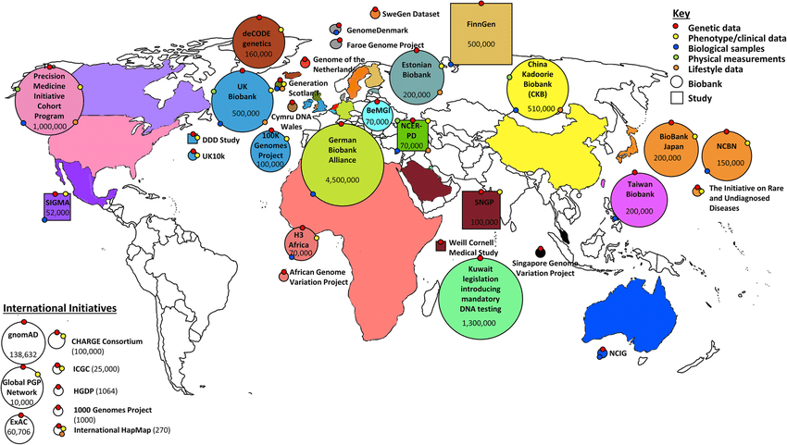

Slide 18


Slide 19


What Data Scientists can do?
In the past: Biologist (domain expert)
Now: Data Scientists -> biologist
First:
Background knowledge
First:
Statistical evidences
Focus on a specific
gene region
Scan whole genome
Identify candidate region
Check if the assumption valid

Slide 20
Q:
大數據 (Big Data) 具備有 “5V” 的性質，所謂的 5V 指的是哪五個性質?
請寫出 (a), (b) 現象在各自在 “5V” 中最符合的性質?
(a) 取得基因體資訊的成本下降，基因體相關研究的樣本數變大，每次研究所面對的資料量也變得很大。
(b) 基因體資料在分析前，常有嚴格的資料清理流程，增加資料可靠度，也進一步增加所得到研究成果的正確性。

Slide 21

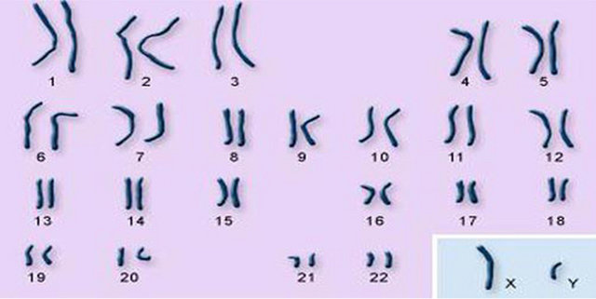
Genome-Wide Association Study (GWAS) (全基因體關聯性分析)
a study of a genome-wide (全基因體) set of genetic variants(基因變量) in different individuals to see if any variant(變量) is associated with a trait (性狀).
GWAS
https://img.jagranjosh.com/images/2022/July/1172022/Compress_world_Population.webp

Slide 22
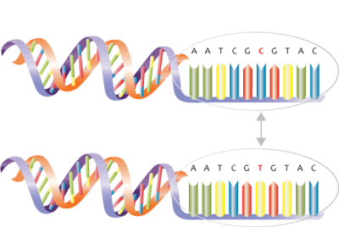
Trait
Hight
Cancer
Drug
Genetic Variants
Continuous linear regression model
Binary logistic regression model
Survival Cox-Proportional hazard model
….

Slide 23
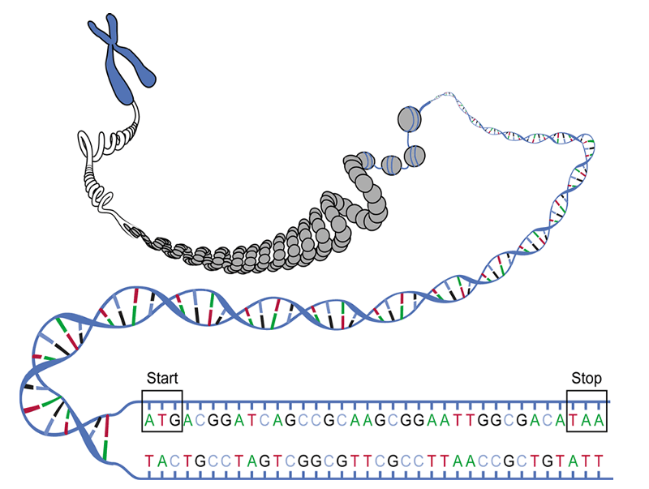
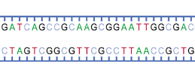
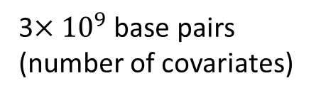
Genetic variants
1 base pair
…
…
3$×{10}^{9}$ base pairs (number of covariates)
http://www.livescience.com/27248-chromosomes.html
Source: https://biologywarakwarak.wordpress.com/2012/01/15/the-3-magical-rules-to-determine-the-amino-acid-chain-from-a-dna-piece-without-error/
Notes:
3 times 10 to the power of 9 : 3 billion (十億)

Slide 24
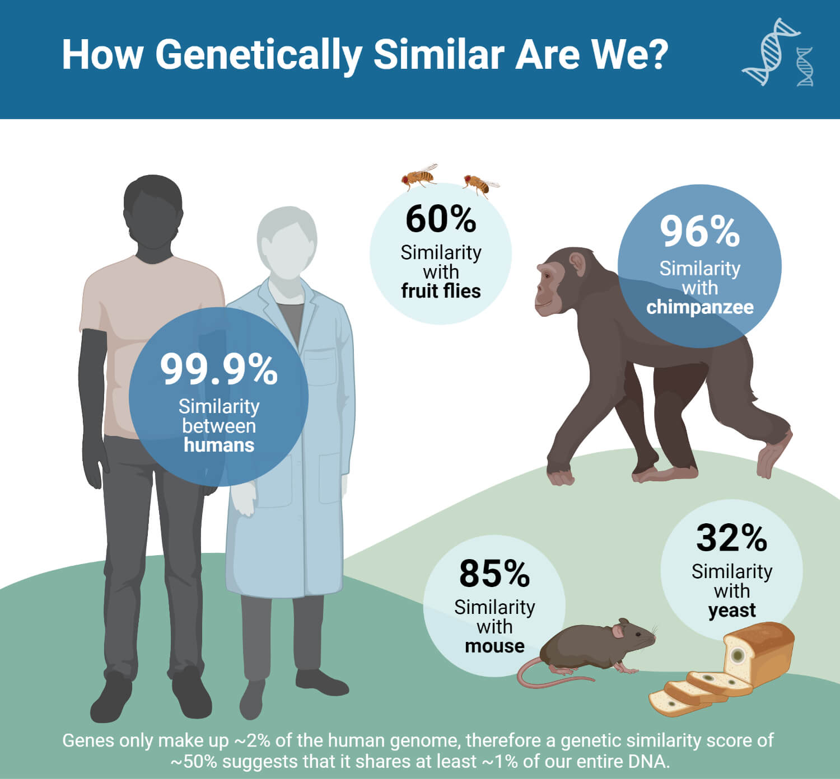
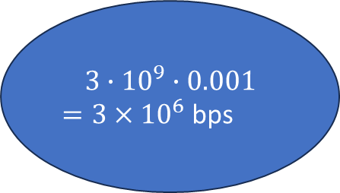
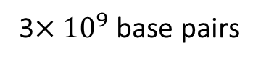
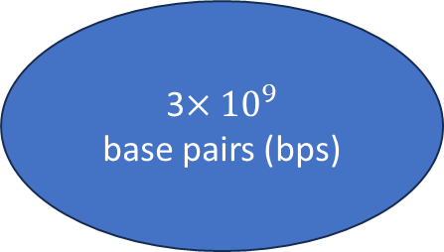
3$×{10}^{9}$
base pairs (bps)
黑猩猩
果蠅
3$×{10}^{9}$ base pairs
$$3∙10^{9}∙0.001$$
$=3×{10}^{6}$ bps
酵母菌
https://microbenotes.com/wp-content/uploads/2023/06/How-Genetically-Similar-Are-We.jpg

Slide 25

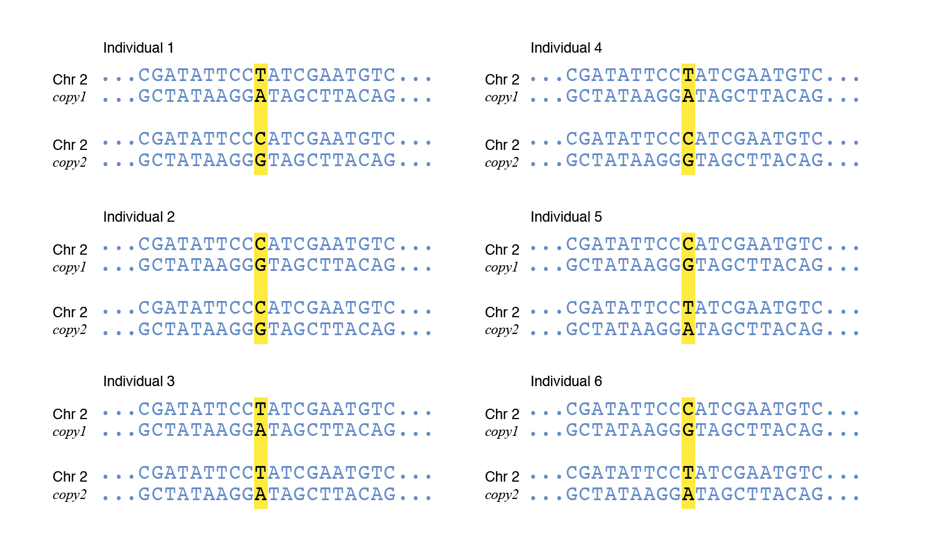
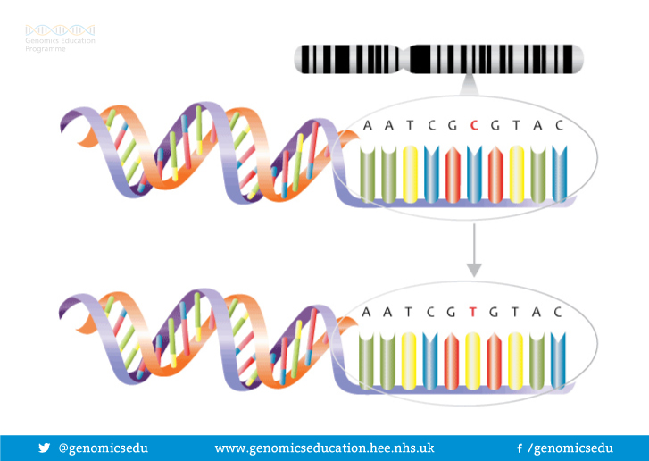
SNP: Single-Nucleotide Polymorphism
單核甘酸多態性
2 allele types in one locus
Allele frequency sufficiently large (>=1%)
TC
TC
CC
CT
TT
CT

Slide 26
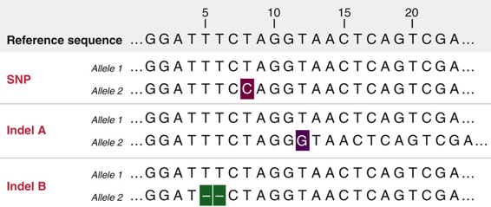
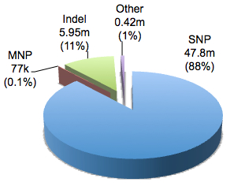
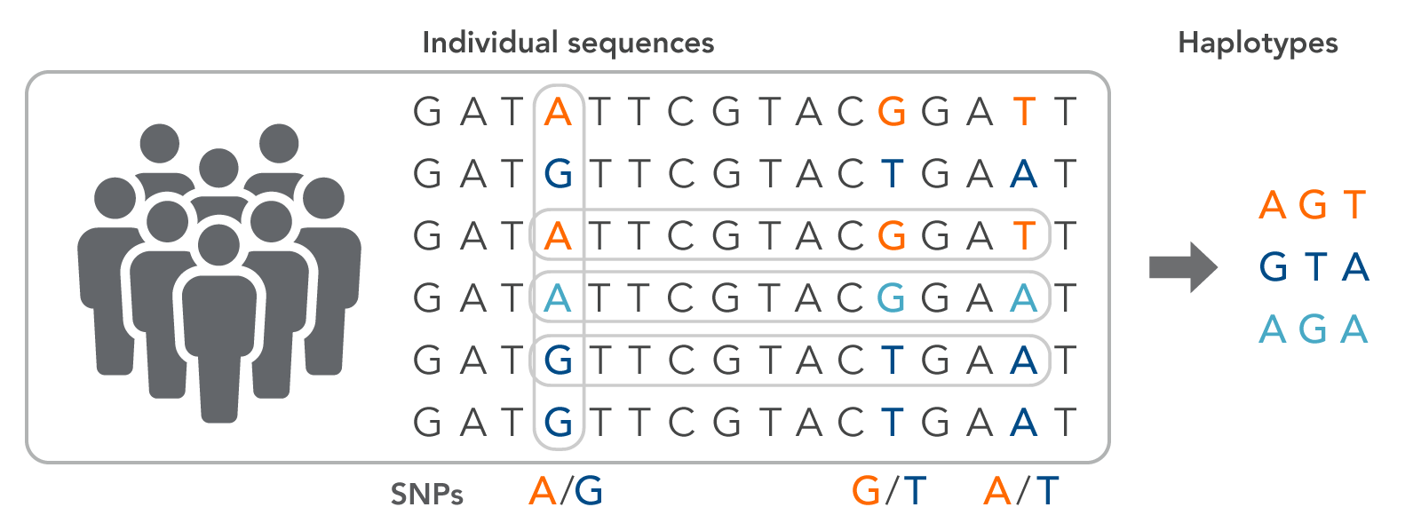
Types of the generic variants
SNP: Single-nucleotide polymorphism
Indel: insertion/deletion
MNP: Multiple Nucleotide Polymorphism
http://www.massgenomics.org/wp-content/uploads/2012/01/dbSNP-variant-composition.jpg

Slide 27
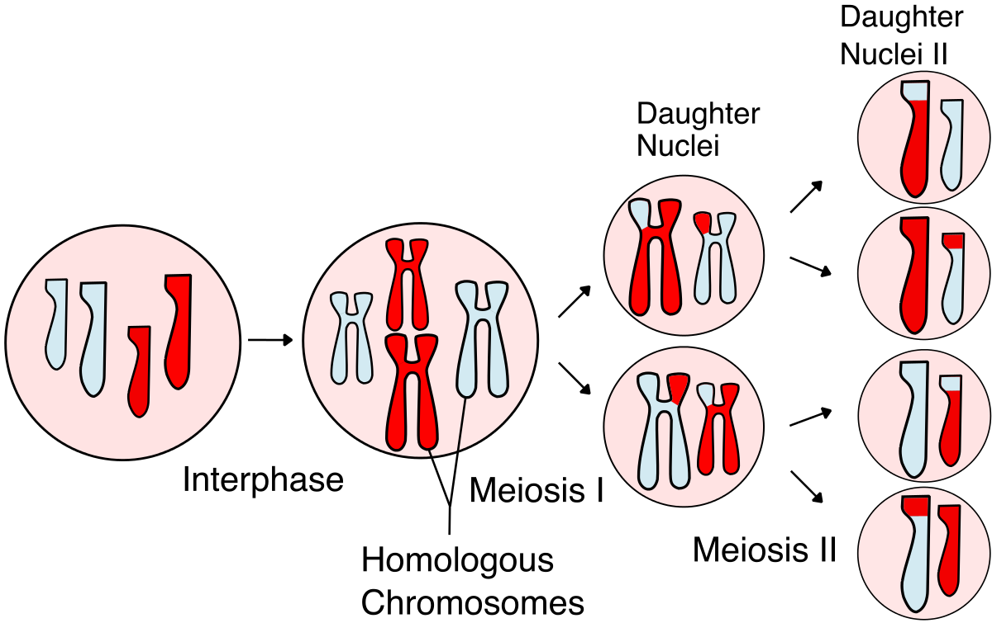
SNPs that are close to each other may be highly correlated
Meiosis (減數分裂): produce sperm or egg cells
Crossover (染色體交叉互換)
This process increases genetic variation among offspring(子孫後代)
子核 (卵母細胞)
間期
減數分裂
減數分裂
Notes:
crossover

Slide 28
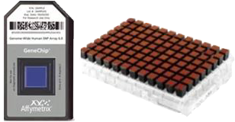
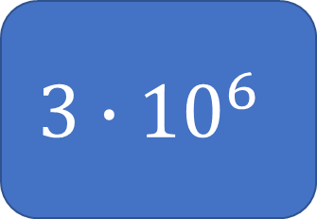
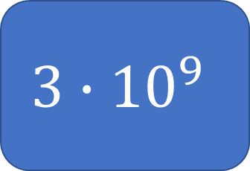
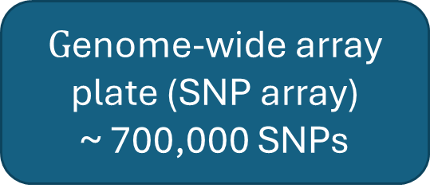
Number of covariates (SNPs)
Remove highly correlated SNPs
Remove no variation
$$3∙{10}^{9}$$
$$3∙{10}^{6}$$
$G$enome-wide array plate (SNP array)
~ 700,000 SNPs
TWB Chip: used in Taiwan Biobank
(台灣人體資料庫)

Slide 29
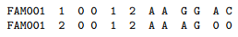
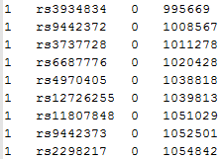
SNP array: data format & Coding
Data format: an example, PED file and MAP file for PLINK, 1000 samples and 200,000 SNPs
1. 2. 3. 4. 5. 6. 7. 8. 9. 10. 11. 12. … (6+200,000$×$2)
1000 rows
…
…
a. b. c. d.
PED file:
1. Family ID
2. Individual ID
3. Paternal ID
4. Maternal ID
5. Sex
6. Phenotype
7. 8. SNP 1
9. 10. SNP2
…..
MAP file:
Chromosome
rs# or snp identifier
Genetic distance
Base-pair position
200,000 rows
…

Slide 30
SNP array: data format & Coding
Data format: an example, PED file for PLINK, 1000 samples and 200,000 SNPs
1. 2. 3. 4. 5. 6. 7. 8. 9. 10. 11. 12. … (6+200,000$×$2)
1000 rows
…
…
Coding:
A SNP has 2 alleles: minor/major allele; minor allele frequency < 0.5
* Additive model {0,1,2} * dominate model {0,1} *recessive {0,1}
PED file:
1. Family ID
2. Individual ID
3. Paternal ID
4. Maternal ID
5. Sex
6. Phenotype
7. 8. SNP 1
9. 10. SNP2
…..
 | SNP1 | SNP2 | SNP3
Minor allele | T | A | C
Sample | SNP1 | SNP2 | SNP3
1 | 0 | 0 | 1
2 | 0 | 1 | NA
Sample | SNP1 | SNP2 | SNP3
1 | 0 | 0 | 1
2 | 0 | 1 | NA
Sample | SNP1 | SNP2 | SNP3
1 | 0 | 0 | 0
2 | 0 | 0 | NA

Slide 31
SNP array: analysis
SNP array QC:
Check genotype quality
SNP call rate, e.g. > 95%, > 99%
Sample call rate, e.g. > 95%
HW equilibrium
Check sample:
sex check
independency
Check population stratification (Principle component analysis)
Check rare variants: e.g. minor allele frequency > 1% or > 5%

Slide 32
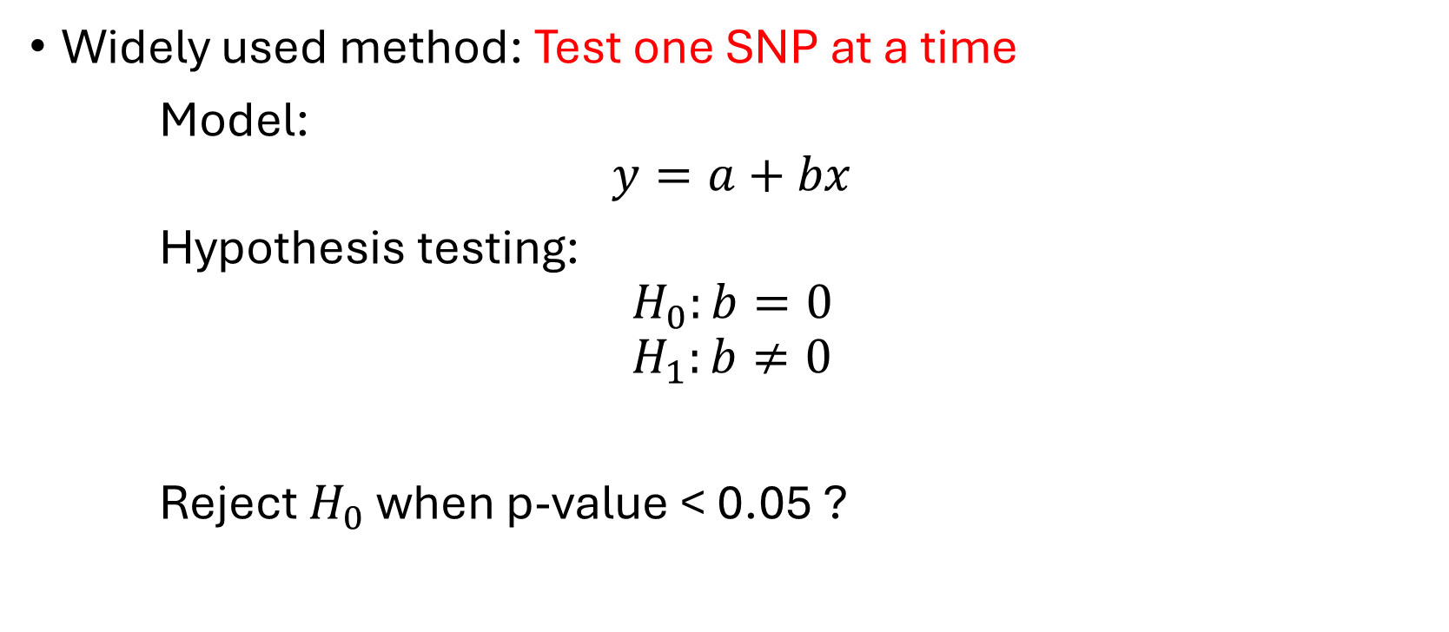
SNP array: analysis/GWAS
Widely used method: Test one SNP at a time
Model:
$$y=a+bx$$
Hypothesis testing:
$$H_{0}:b=0$$
$$H_{1}:b≠0$$
Reject $H_{0}$ when p-value < 0.05 ?

Slide 33
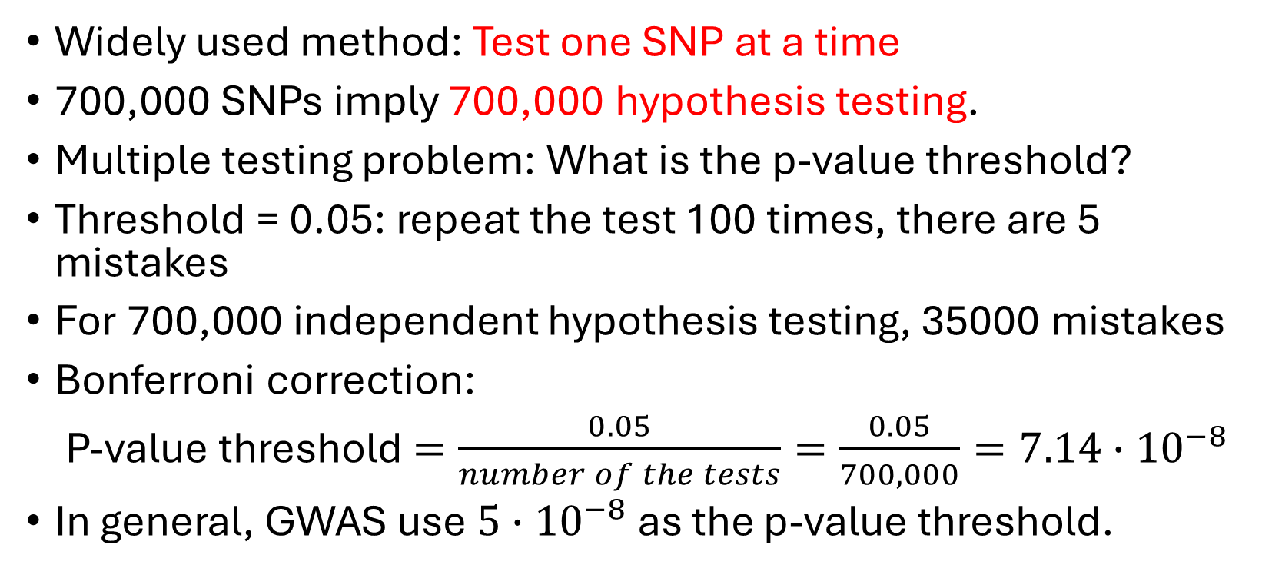
SNP array: analysis/GWAS
Widely used method: Test one SNP at a time
700,000 SNPs imply 700,000 hypothesis testing.
Multiple testing problem: What is the p-value threshold?
Threshold = 0.05: repeat the test 100 times, there are 5 mistakes
For 700,000 independent hypothesis testing, 35000 mistakes
Bonferroni correction:
P-value threshold $=\frac{0.05}{number of the tests}=\frac{0.05}{700,000}=7.14∙{10}^{−8}$
In general, GWAS use $5∙{10}^{−8}$ as the p-value threshold.

Slide 34

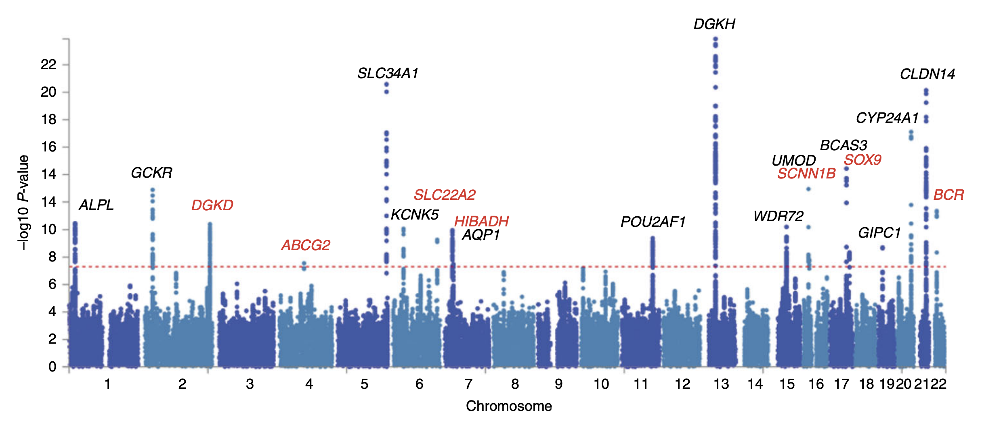
Manhattan plot
Manhattan skyline 曼哈頓天際線
https://www.google.com/url?sa=i&url=https%3A%2F%2Fwww.hotcore.info%2Fbabki%2FRelated-Search-Manhattan-Skyline.htm&psig=AOvVaw3E5IjVcW3WM1s7P6E4o9l2&ust=1695544484837000&source=images&cd=vfe&opi=89978449&ved=0CBAQjRxqFwoTCPDTzMepwIEDFQAAAAAdAAAAABA0
https://upload.wikimedia.org/wikipedia/commons/thumb/4/4f/Manhattan_plot_from_a_GWAS_of_kidney_stone_disease.png/1200px-Manhattan_plot_from_a_GWAS_of_kidney_stone_disease.png

Slide 35
Q
3. 假設我們將進行一個全基因體關聯性分析 (GWAS), 在這個分析中，我們收集了 600,000 個基因位點 (SNPs)，研究的性狀 (trait) 為乳癌，我們想要找出和乳癌的發生相關的基因位點 (SNPs)。請問在這項研究中，p-value 門檻 (threshold) 為何? (利用 Bonferroni correction)

Slide 36
主成分分析(PCA)

Slide 37
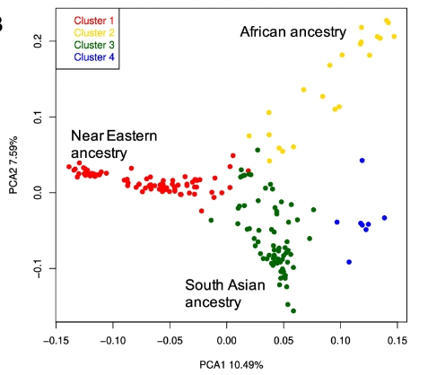
the population stratification(人群混雜)
In the genetic study, we need to pay attention to the population stratification problem.
For example, GWAS study

Slide 38
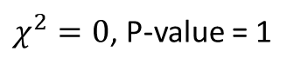
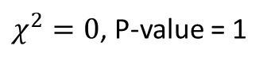
Why do we care? An example.(1)
Genetics of chopstick (筷子) use
Americans | Use of chopsticks
Allele (gene) | Yes | No | Total
A1 | 320 | 320 | 640
A2 | 80 | 80 | 160
Total | 400 | 400 | 800
$χ^{2}=0$, P-value = 1
Chinese | Use of chopsticks
Allele (gene) | Yes | No | Total
A1 | 320 | 20 | 340
A2 | 320 | 20 | 340
Total | 640 | 40 | 680
$χ^{2}=0$, P-value = 1
Hamer&Sirota, Molecular Psychiatry (2000)

Slide 39
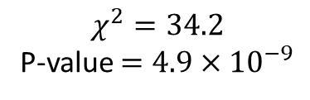
Why do we care? An example.(2)
Genetics of chopstick (筷子) use
Americans + Chinese | Use of chopsticks
Allele (gene) | Yes | No | Total
A1 | 640 | 340 | 640
A2 | 400 | 100 | 160
Total | 1040 | 440 | 1480
$$χ^{2}=34.2$$
P-value $=4.9×{10}^{−9}$
False positive

Slide 40
PCA (Principle Component Analysis)
Extracts principal components of the variance-standardized relationship matrix
在全基因體研究中，我們可以利用 PCA 來區分不同的基因族群，避免人群混雜的問題。

Slide 41
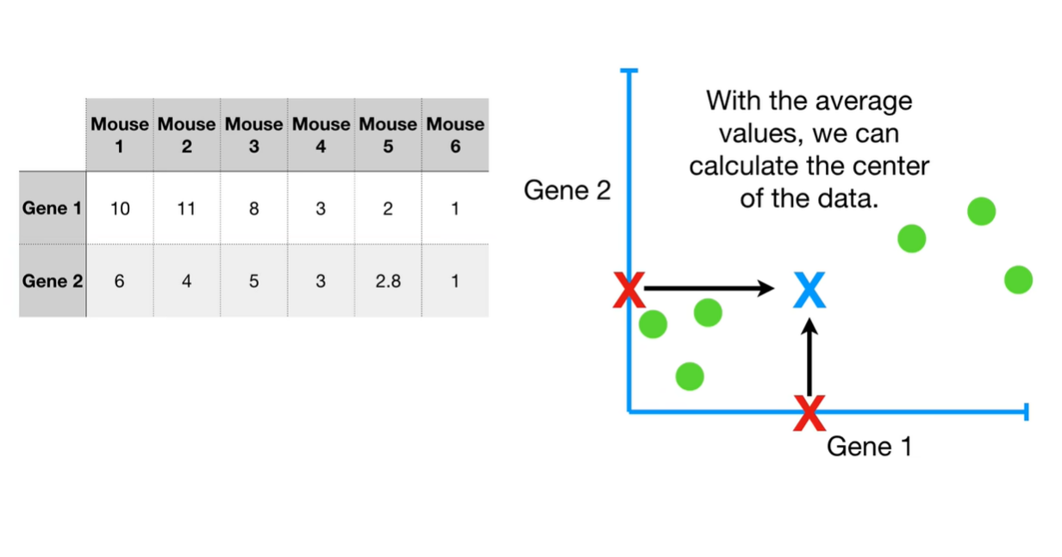
PCA: example p=2
Gene expression data (RNA level)
Continuous variable

Slide 42

PCA: example p=2

Slide 43

PCA: example p=2

Slide 44

PCA: example p=2

Slide 45



Supervised learning vs Unsupervised learning

Slide 46

Supervised learning vs Unsupervised learning
監督式學習
非監督式學習
大數據視覺化
身分詐騙偵測
市場預測
目標行銷
客戶推薦
https://www.labellerr.com/blog/content/images/size/w2000/2023/02/bannerSupervised-vs.-Unsupervised-Learning-1.webp

Slide 47

1000 genome project
(Phase 3) 2504 samples
Chr 21: 1,103,547

Slide 48

2000: Human Genome Project Completed
2007: 1000 Genome Project formally proposed in UK
2012: First release of complete genomics data
2014: First release of Phase 3 variants

Slide 49

Data preprocessing 資料前處理
http://ftp.1000genomes.ebi.ac.uk/vol1/ftp/release/20130502/ (variants data)
http://ftp.1000genomes.ebi.ac.uk/vol1/ftp/release/20130502/integrated_call_samples_v3.20130502.ALL.panel (phenotype data)
PLINK (software): PLINK's primary job is management and analysis of position-based SNP-like data for thousands of samples.
 | type | size
Raw file | ALL.chr21*.vcf.gz | 201M (2504 samples/ 1,103,547 variants)
Bed file | .bed | 661M
Remove MAF < 0.01 | .bed | 116M (2504 samples/ 193,739 variants)
.bed -> .ped | .ped | 2G
Remove high LD | .ped | 217M (2504 samples/ 21,051 variants)

Slide 50

MDS: Distance among samples
IBS: identity by state

Slide 51
Population Code | Description | Super Population 2504
CHB | Han Chinese in Bejing, China 北京 | EAS 東亞 661
JPT | Japanese in Tokyo, Japan 東京 | EAS
CHS | Southern Han Chinese | EAS
CDX | Chinese Dai in Xishuanagbanna, China | EAS
KHV | Kinh in Ho Chi Minh City, Vietnam | EAS
CEU | Utah Residents (CEPH) with Northern and Western European ancestry | EUR 歐洲 347
TSI | Toscani in Italia | EUR
FIN | Finnish in Finland | EUR
GBR | British in England and Scotland | EUR
IBS | Iberian population in Spain | EUR
YRI | Yoruba in Ibadan, Nigera | AFR 非州 504
LWK | Luhya in Webuye, Kenya | AFR
MAG | Mandinka in The Gambia | AFR
MSL | Mende in Sierra Leone | AFR
ESN | Esan in Nigera | AFR
ASW | American's of African Ancestry in SW USA | AFR
ACB | African Carribean in Barbados | AFR
MXL | Mexican Ancestry from Los Angeles USA | AMR 503 拉丁美洲、美洲原住民和非洲裔美洲人等混合人种
PUR | Puerto Rican from Puerto Rica | AMR
CLM | Colombian from Medellian, Colombia | AMR
PEL | Peruvian from Lima, Peru | AMR
GIH | Gujarati Indian (印度) from Houston, Texas | SAS 南亞 489
PJL | Punjabi from Lahore, Pakistan (巴基斯坦) | SAS
BEB | Bengali from Bangladesh (孟加拉) | SAS
STU | Sri Lankan (斯里蘭卡) Tamil from the UK | SAS
ITU | Indian (印度) Telugu from the UK | SAS

Slide 52

Population Code | Description | Super Population 2504
CHB | Han Chinese in Bejing, China 北京 | EAS 東亞 661
JPT | Japanese in Tokyo, Japan 東京 | EAS
CHS | Southern Han Chinese | EAS
CDX | Chinese Dai in Xishuanagbanna, China | EAS
KHV | Kinh in Ho Chi Minh City, Vietnam | EAS
CEU | Utah Residents (CEPH) with Northern and Western European ancestry | EUR 歐洲 347
TSI | Toscani in Italia | EUR
FIN | Finnish in Finland | EUR
GBR | British in England and Scotland | EUR
IBS | Iberian population in Spain | EUR
YRI | Yoruba in Ibadan, Nigera | AFR 非州 504
LWK | Luhya in Webuye, Kenya | AFR
MAG | Mandinka in The Gambia | AFR
MSL | Mende in Sierra Leone | AFR
ESN | Esan in Nigera | AFR
ASW | American's of African Ancestry in SW USA | AFR
ACB | African Carribean in Barbados | AFR
MXL | Mexican Ancestry from Los Angeles USA | AMR 503 拉丁美洲、美洲原住民和非洲裔美洲人等混合人种
PUR | Puerto Rican from Puerto Rica | AMR
CLM | Colombian from Medellian, Colombia | AMR
PEL | Peruvian from Lima, Peru | AMR
GIH | Gujarati Indian (印度) from Houston, Texas | SAS 南亞 489
PJL | Punjabi from Lahore, Pakistan (巴基斯坦) | SAS
BEB | Bengali from Bangladesh (孟加拉) | SAS
STU | Sri Lankan (斯里蘭卡) Tamil from the UK | SAS
ITU | Indian (印度) Telugu from the UK | SAS

Slide 53

MDS
AFR, African (661)
AMR, Ad Mixed American (347)
EAS, East Asian (504)
EUR, European (503)
SAS, South Asian (489)

Slide 54

PCA
AFR, African (661)
AMR, Ad Mixed American (347)
EAS, East Asian (504)
EUR, European (503)
SAS, South Asian (489)

Slide 55

Gender

Slide 56
Summary (Take home message)
Genomic Data Science: 遺傳學相關巨量資料的出現，統計、資訊需求增加
全基因體關聯性分析 (GWAS): Bonferroni correction
主成份分析 (PCA): 族群混雜問題
5V in Big Data; Supervised learning vs Unsupervised learning

Slide 57
Q:
大數據 (Big Data) 具備有 “5V” 的性質，所謂的 5V 指的是哪五個性質?
請寫出 (a), (b) 現象在各自在 “5V” 中最符合的性質?
(a) 取得基因體資訊的成本下降，基因體相關研究的樣本數變大，每次研究所面 對的資料量也變得很大。
(b) 基因體資料在分析前，常有嚴格的資料清理流程，增加資料可靠度，也進一 步增加所得到研究成果的正確性。
假設我們將進行一個全基因體關聯性分析 (GWAS), 在這個分析中，我們收集了 600,000 個基因位點 (SNPs)，我們想要找出和乳癌的發生相關的基因位點 (SNPs)。請問在這項研究中，p-value 門檻 (threshold) 為何? (利用 Bonferroni correction)
主成分分析(PCA) 屬於監督式學習 (Supervised learning) 或非監督式學習(Unsupervised learning) ?

